Slide 1
Social Influence:
Conformity, Compliance, Obedience

Slide 2
Social Influence
Main Determinants of Social Influence
Compliance
(Response to a direct request)
Obedience
(Response to authority)
Conformtiy
(Response to social norms)
Doing something (or not doing something) because someone asked you to
Doing something (or not doing something) because a superior asked you to
Doing something (or not doing something) because others are

Slide 3
What is Conformity?
Conformity –
  “a change in a person’s behaviour or belief as a result of real or imagined group norms”. (Myers, 1999)
Or
  “a tendency for people to adopt the behaviour, attitudes and values of other members of a reference group”. (Zimbardo, 1995)
Norms =
  the unwritten rules, beliefs, attitudes and behaviours established by a group to regulate the behaviour of its members.

Slide 4
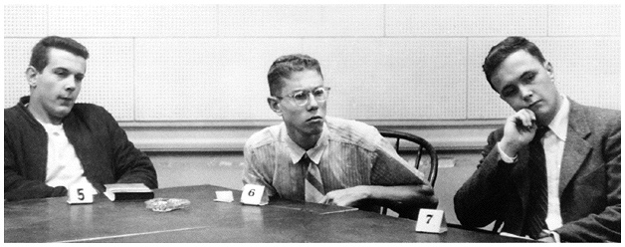
Reasons for Conformity
Informational Social Influence
  We want to be right
  We look to others, whom we believe to be correct, to give us information about how to behave, particularly in novel or ambiguous situations. (The desire to be right)
Normative Social Influence
  We want to be liked
  We conform because we think that others will approve and accept us. (The desire to be accepted)

Slide 5
Conformity: Asch
CONFORMITY IN AN UNAMBIGUOUS SITUATION.
Solomon Asch (1951) carried out a study to show the pressure which peers can put on you to conform to a wrong norm.
Enter laboratory with 6 other people. Seven of you seated in a series - you are number 6.
Experimenter explains task:
a single line on card on left
3 lines on card on right.

Slide 6
A B C

Slide 7
Social Influence:
Compliance

Slide 8
Compliance
A change in behavior due to a direct request from another person.
There are many different situations where compliance comes into play. Some examples include:
  Buying something because a salesperson makes a pitch and then asks you to make a purchase
  Agreeing when a friend asks, "Can you do me a favor?"
  Seeing an ad on a website, clicking it, and then making a purchase

Slide 9
Why Compliance?
People make direct requests of us all the time
  Salespeople
  Peers
  Friends
  Family
Honoring those (reasonable) requests helps maintain the social fabric
  By helping others and anticipating their help in the future in future strong social bonds are formed which increase success in life

Slide 10
Compliance
Strategies in compliance
    Foot-in-the-door
    Door-in-the-face
    Reciprocity
    Low-Ball
    Ingratiation

Slide 11
Compliance
The Foot-in-the-Door Technique
The foot-in-the-door technique gets people to comply with a small request, followed by a larger request.
This is better for long-term compliance.
Example: Someone asks you to fill in for them in a game of basketball, after you say yes they ask you to fill in for the rest of the season

Slide 12
Compliance
The door-in-the-face technique gets people to comply with a request by presenting them first with a large request and then with a smaller, more reasonable request.
Example: Asking someone to buy you lunch at the canteen, when they decline you ask for just a drink instead

Slide 13
Compliance
Reciprocity :
Receiving anything positive from another person requires them to reciprocate in response.
Eg) A gym gives away a free week trial in the hopes that people will sign up for a longer term

Slide 14
Compliance
The low-ball technique gets people to comply by first getting them to make a commitment then raising the stakes or cost of the commitment.
Eg) A sales person might give you a low price for something you want to buy, then say they must check with their manager first; before returning with a higher price.

Slide 15
Compliance
The ingratiation technique gets people to comply by gaining approval of the person first.
Eg) Complimenting a friend on their new shoes before asking them a favour.

Slide 16
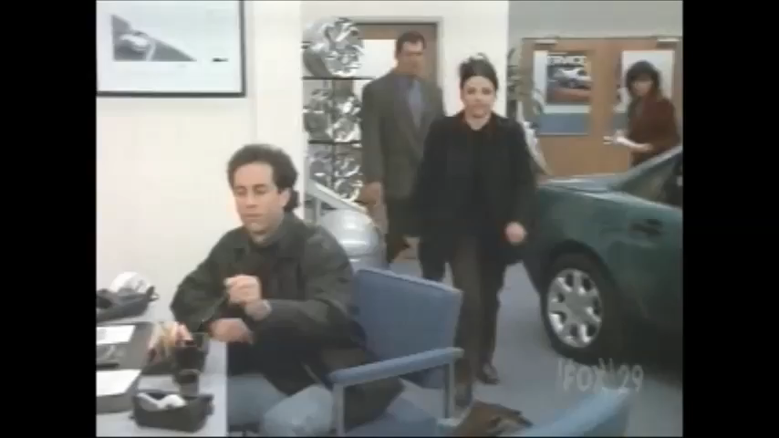
Which technique is this!?

Slide 17
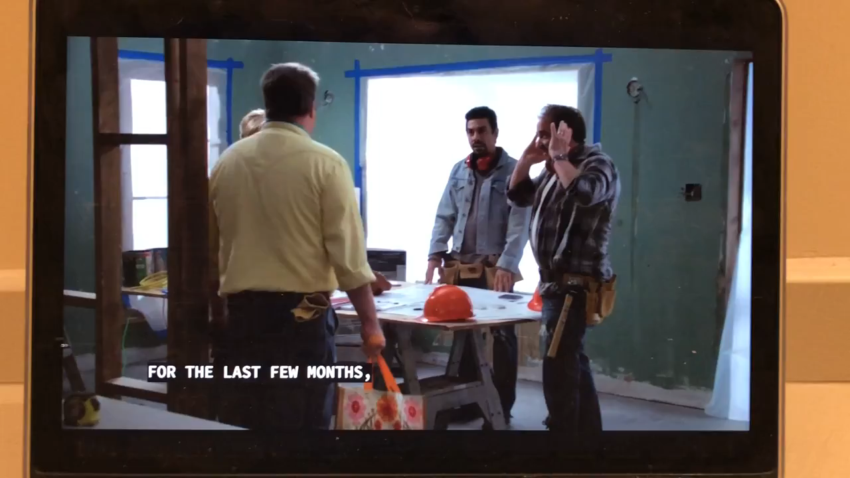
Which technique is this!?

Slide 18
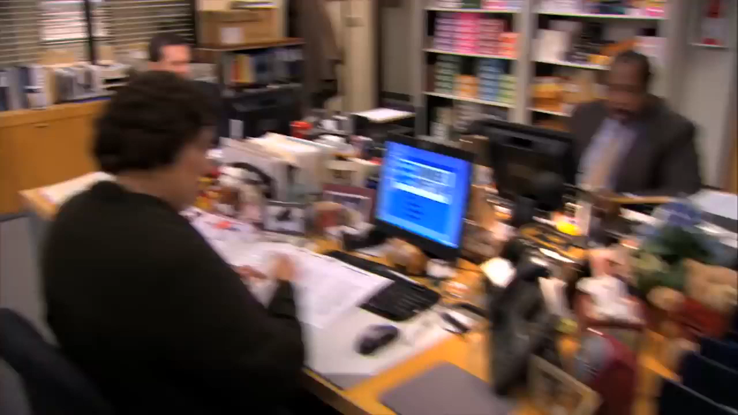
Which technique is this!?

Slide 19
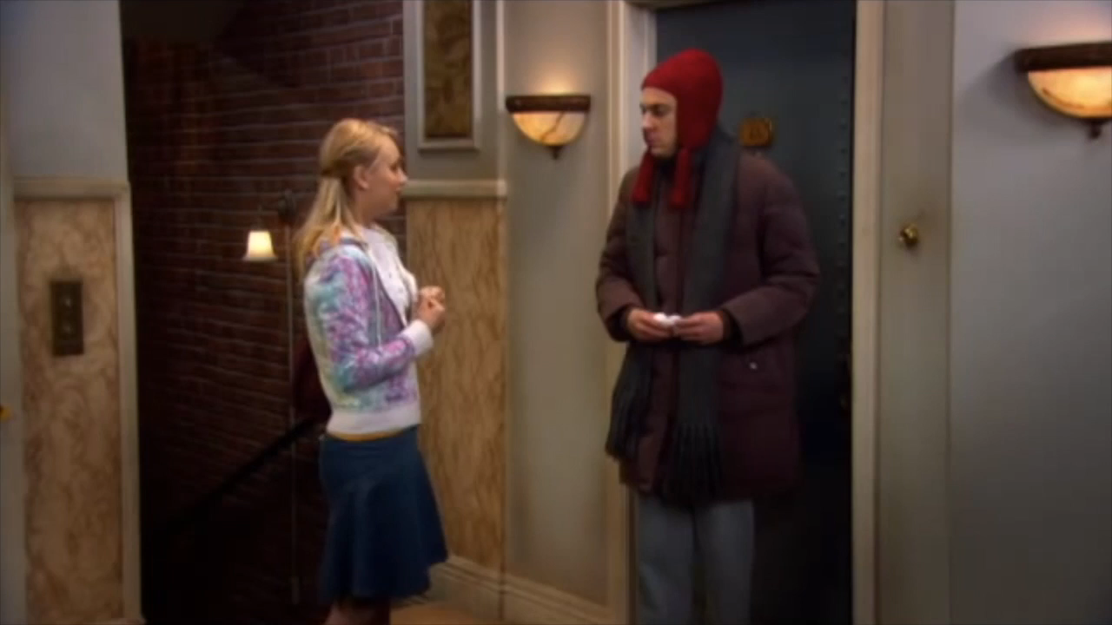
Which technique is this!?

Slide 20
Answers:
Seinfeld = Low-Ball
Modern Family = Door in the Face
The Office = Reciprocity
The Big Bang Theory = Door in the Face, followed by Foot in the Door.

Slide 21
Social Influence
Obedience

Slide 22
Obedience is a form of social influence that involves performing an action under the orders of an authority figure.
It differs from compliance (which involves changing your behavior at the request of another person) and conformity (which involves altering your behavior in order to go along with the rest of the group)

Slide 23
Obedience
Doing something because a legitimate authority figure asked us to
Less frequent than conformity or compliance
  Even persons who possess authority and power generally prefer to exert it through the velvet glove
    Through requests rather than orders

Slide 24
Obedience
Obedience
  behaving as instructed but not necessarily changing your opinions.
Usually in response to individual rather than group pressure
Obedience is by direction (being directed) whereas conformity is affected by example (or observation).

Slide 25
Why Obedience?
Many people have power over us
  law enforcement,
  parents,
  military
Following the direct orders of a (legitimate) authority is usually not a matter of debate
  when the officer asks to see your driver’s license, it’s usually prudent to obey

Slide 26
Obedience to Authority
Stanley Milgram (1963, 1974, 1976)
  examined the power of obedience to authority in social psychology’s most famous laboratory experiments.
Milgram’s results indicate
  powerful tendency people have to obey authority figures even when their orders go against people’s values and morals.

Slide 27
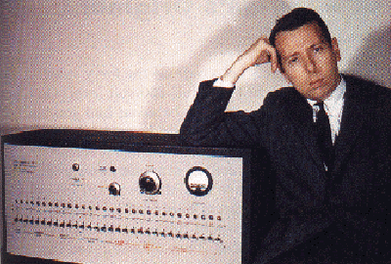
Obedience
Obedience
  compliance of person is due to perceived authority of asker
  request is perceived as a command
Milgram interested in unquestioning obedience to orders
Notes:
This photo of Stanley Milgram was scanned in from the Myers text, NOT on the CD

Slide 28
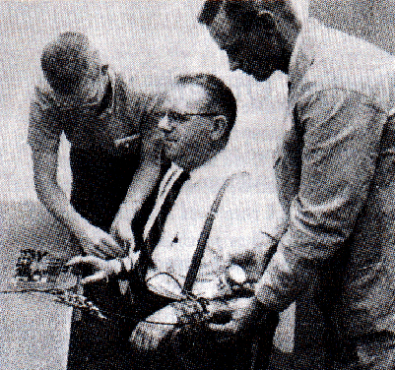
Stanley Milgram’s Studies
Stanley Milgram (1960’s)
  The participant is the “teacher”, the confederate is the “learner”
  Teacher watches learner being strapped into chair -- learner expresses concern over his “heart condition”
  If the learner makes an error, the teacher has to ‘shock’ him…with the level of shock increasing to dangerous and deadly levels
  As the level of shock increases, the “teacher” can hear the learner is in obvious pain
Notes:
Photo scanned in from Gray 3e fig 14.8, NOT on CD

Slide 29
Stanley Milgram’s Studies
Teacher to another room with experimenter
  Shock generator panel –
    15 to 450 volts,
    labels “slight shock” to “XXX”
  Asked to give higher shocks for every mistake learner makes
Notes:
Figure adapted from Hockenbury 12.4, was on CD

Slide 30
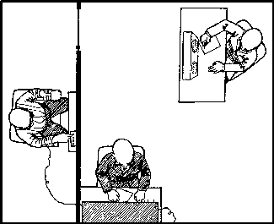
Stanley Milgram (1963)

Slide 31
Stanley Milgram’s Studies
Shock
Level
Switch Labels
and Voltage Levels
Shock
Level
Switch Labels
and Voltage Levels
“Slight Shock”
15
30
45
60
“Moderate Shock”
75
90
105
120
“Strong Shock”
135
150
165
180
“Very Strong Shock”
195
210
225
240
“Intense Shock”
255
270
285
300
“Extreme Intensity Shock”
315
330
345
360
“Danger: Severe Shock”
375
390
405
420
“XXX”
435
450
1
2
3
4
5
6
7
8
9
10
11
12
13
14
15
16
17
18
19
20
21
22
23
24
25
26
27
28
29
30
Notes:
Figure adapted from Hockenbury 12.4, was on CD

Slide 32
Stanley Milgram’s Studies
Learner protests more and more as shock increases
Experimenter continues to request obedience even if teacher is unsure
120
150
300
330
“Ugh! Hey this really hurts.”
“Ugh! Experimenter! That’s all.
get me out of here. I told you
I had heart trouble. My heart’s
starting to bother me now.”
(agonized scream) “I absolutely
refuse to answer any more.
get me out of here You can’t hold
me here. Get me out.”
“(intense & prolonged agonized
scream) “Let me out of here.
Let me out of here. My heart’s
bothering me. Let me out,
I tell you…”
Notes:
This table was adapted from Hockenbury, Table 12.3
Instructor could also tape the confederate’s responses instead of using this table

Slide 33
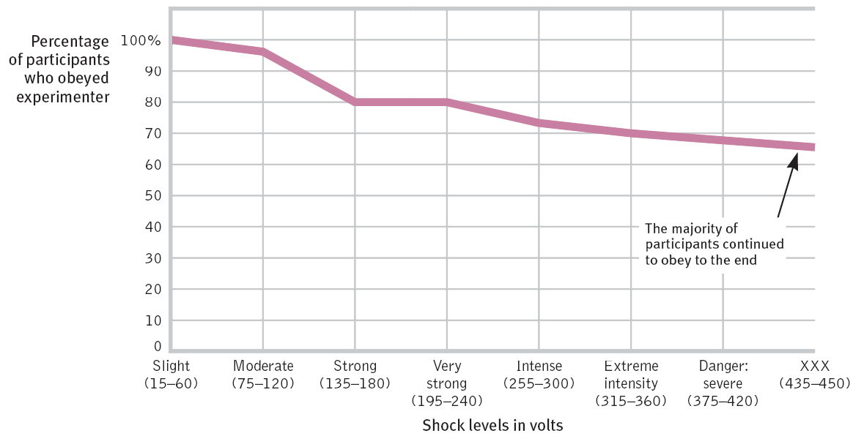
How far did obedience go?
Notes:
No animation.

Slide 34
What factors increase obedience?
When orders were given by:
  Someone with legitimate authority
  Someone associated with a prestigious institution
  Someone standing close by
When the “learner”/victim is in another room
When other participants obey/no one disobeys (no defiant role model)
Notes:
Lessons from this??
- when under pressure to obey, people with principles will say and do things they never would have believed they would do
- BUT, to call a person committing a harmful act and to assume they are cruel or evil might be wrong – in fact, we would be making the fundamental attribution error (remember that???)
When we go too far in assuming that a person’s behavior is caused by their personality.
SO: the evil may be in the situation!

Slide 35
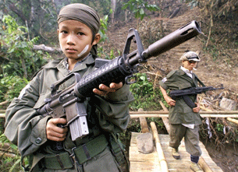
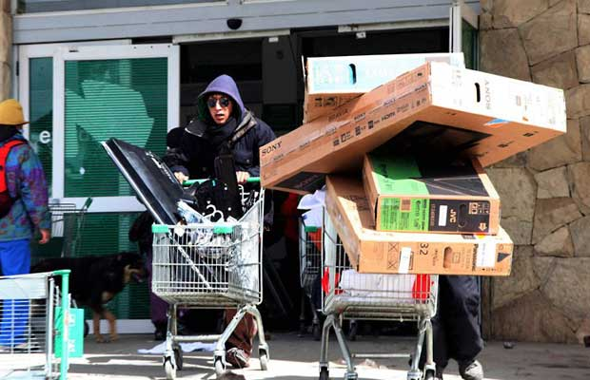
The power of a given situation can easily override individual differences in personality.

